Slide 1


GHOUSIA COLLEGE OF ENGINEERING
RAMANAGARA - 562159
A Project Presentation on
“UTILIZING IOT FOR SOLAR PANEL MONITORING”
Under the guidance of
Prof. MOHAMMED ELAHI
Presenting By
JAZIB HASSAN MOHAMMAD FARMAN SAMEER
SYED NABIL UR RAHMAN
1GC20CS018
1GC20CS031
1GC20CS049
1GC20CS056

Slide 2
Contents
Introduction
Literature Survey
Objective
Problem Definition
Proposed System
Methodology
Architectural Diagram
Object Detection
Application
Result’s
Advantages

Slide 3
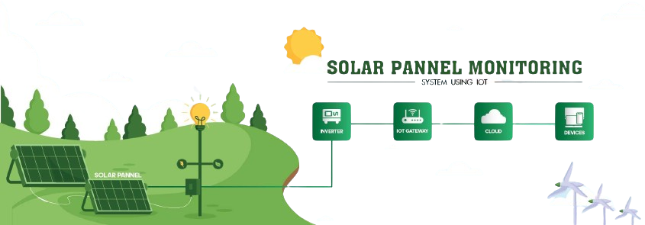
Introduction
Solar power plants need to be monitored for optimum power output. This helps retrieve efficient power output from power plants while monitoring for faulty solar panels.
Here we propose an automated IOT based solar power monitoring system that allows for automated solar power monitoring from anywhere over the internet
It constantly monitors the solar paneland transmits the power output to IOT system over the internet.

Slide 4
Literature Survey
Vishal Singh et.al., “IoT based solar panel monitoring system”
Aimed to Optimize Power Output.
Performance of panel is inherently tied to the energy received by solar cell.
Provides information about the load being powered by the panels.
Balakrishnan D et.al., “IoT based system for fault detection and diagnosis in solar pv panels”
IoT based system designed for detection and diagnosis of pv panel.
The system has ability to identify faults in real time.
Primary objective is to enhance the performance.

Slide 5
T Asha Rakshana et.al., “IoT based solar panel fault monitoring and control by using wi-fi modem”
Increase production by rectifying the issue.
Integrating a smart home network within the Solar System.
Detection the fault occur through the Light Dependent Resistor(LDR).
Preethi Sekar et.al., “IoT based Solar Energy Monitoring”
Enhancing the Efficiency by incorporation of solar tracker.
Track’s the Sun position and direction to optimize Sun Exposure on it’s surface.
Utilizes the Maximum Power Point Tracking Mechanism (MPPT).

Slide 6
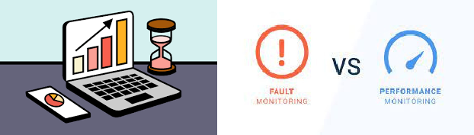
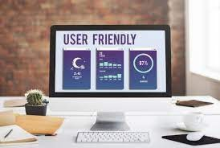
Objective of the Project
Real-Time Data Collection
Examine Data for Overall Energy Production
Aiding in pinpoint fault Detection & Monitoring Provides User-Friendly Interface

Slide 7

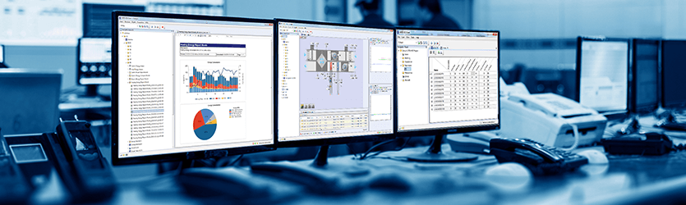
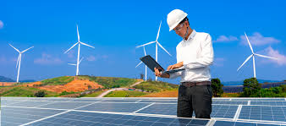
Problem Definition
1
Performance Optimization
2
Monitoring and Management
Performance optimization for solar panels involves enhancing efficiency through improved materials, better positioning, regular maintenance, and advanced tracking systems.
Maintenance and monitoring of solar panels involve cleaning, inspecting for damage, and tracking performance metrics regularly.
3
Detection and Diagnostics
Detecting and diagnosing solar panels involve inspecting for efficiency, damage, and connectivity using thermal imaging and electrical tests.

Slide 8
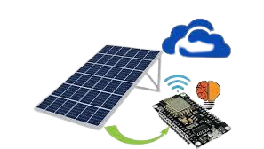
Proposed System
Real time data collection.
Data Transmission
Analytics & Monitoring
Energy Efficiency

Slide 9
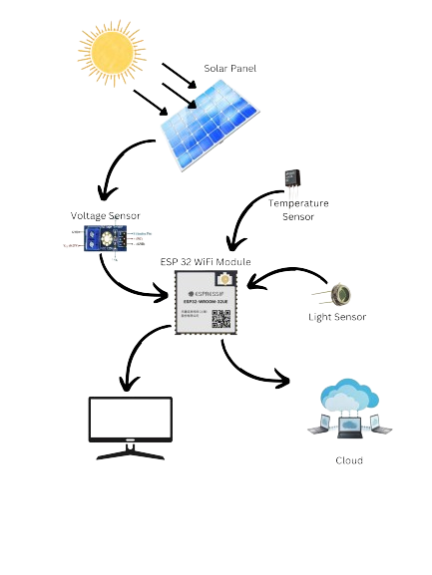
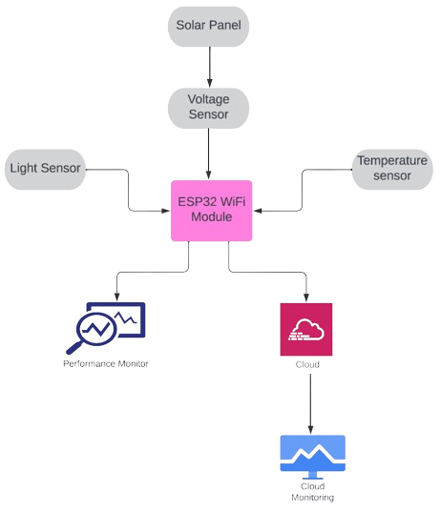
Methodology
Fig. Graphical Representation of System
Fig. Block Diagram of the system

Slide 10
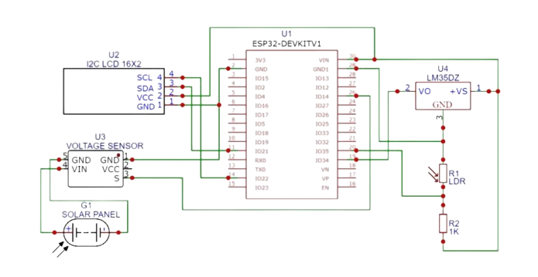
Architecture Diagram
Solar Panel
ESP32 Wi-fi Module Voltage Sensor Module
Light Dependent Resistor
16x2 I2C LCD Display Resistor 2.2k
Vero Board
LM35 Temperature Sensor

Slide 11
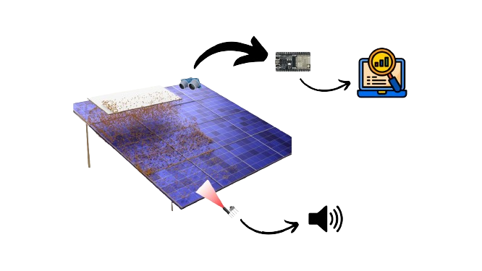
Object detection

Slide 12
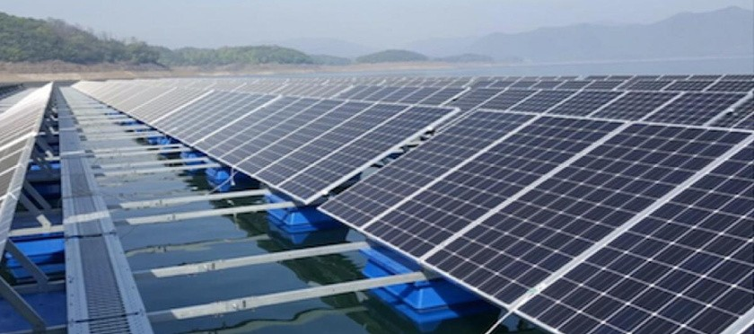
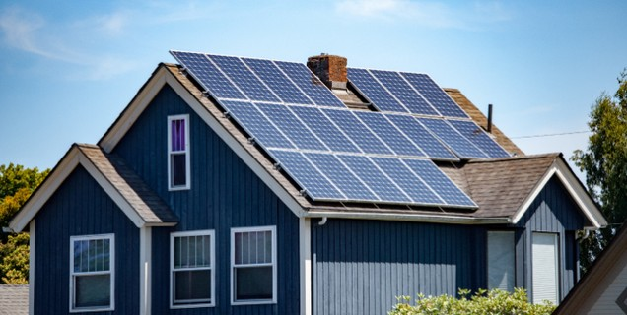
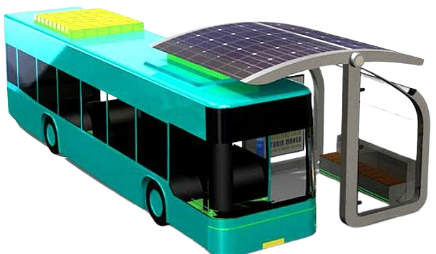
Applications
Solar Farm’s
Smart Home Integration
Solar Powered Transportation

Slide 13
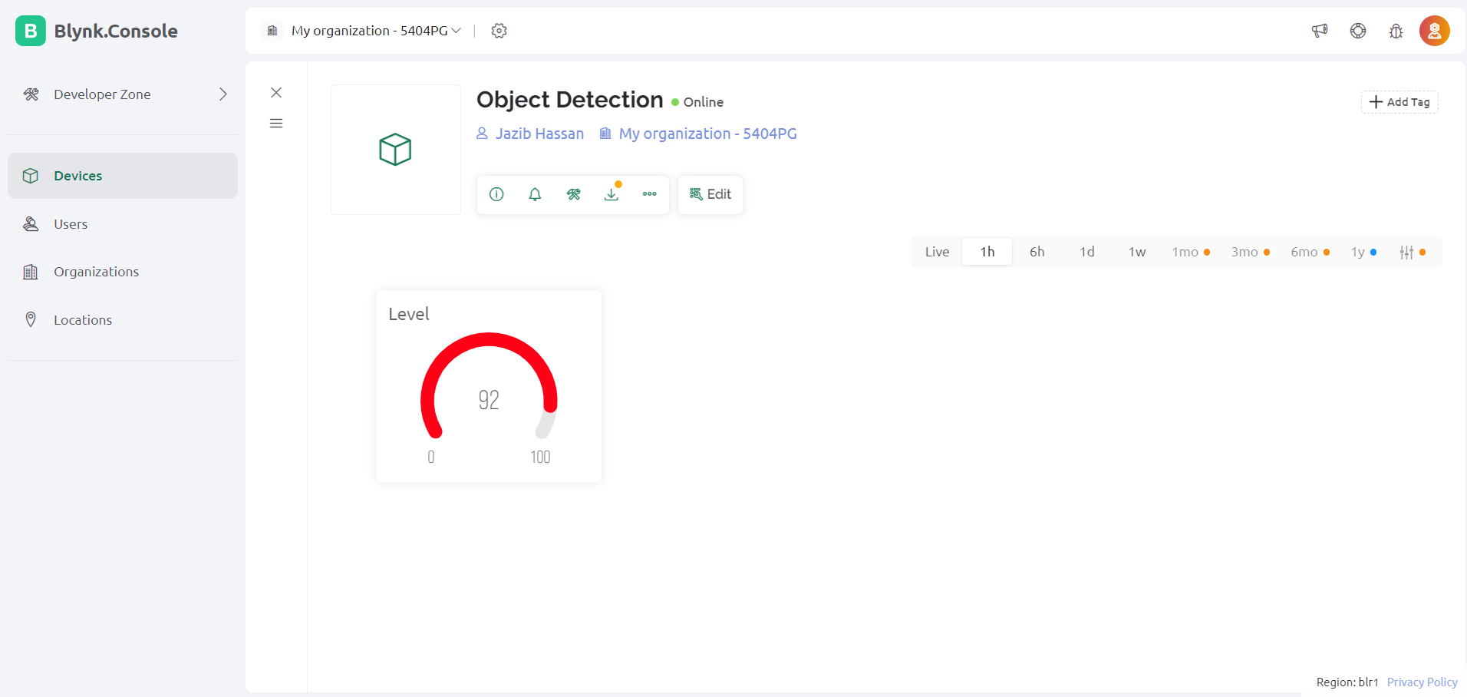
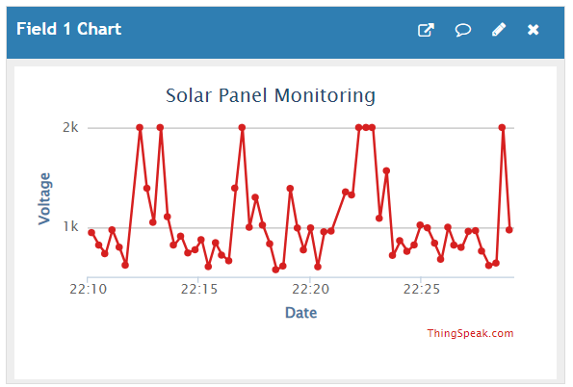
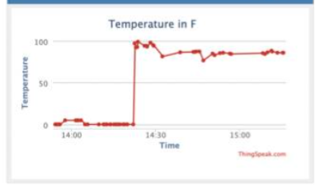
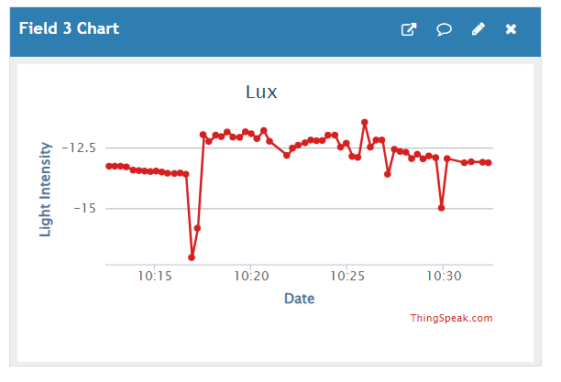
Output’s

Slide 14
Advantages
Immediate Data access
Remote Management
Efficient Maintenance
Energy Optimization
Data Analytics
Scalability
Integration with other System

Slide 15
Thank -You

